Slide 1
Welcome!
We Are Glad You Are Here!

Slide 3
I Cor. 6:9-11
(9) “Do you not know that the unrighteous will not inherit the kingdom of God? Do not be deceived. Neither fornicators, nor idolaters, nor adulterers, nor homosexuals, nor sodomites,

Slide 4
I Cor. 6:9-11
(10) nor thieves, nor covetous, nor drunkards, nor revilers, nor extortioners will inherit the kingdom of God.

Slide 5
I Cor. 6:9-11
(11) And such were some of you. But you were washed, but you were sanctified, but you were justified in the name of the Lord Jesus and by the Spirit of our God.

Slide 7
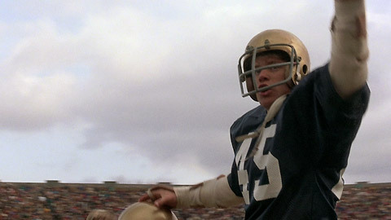

Slide 8
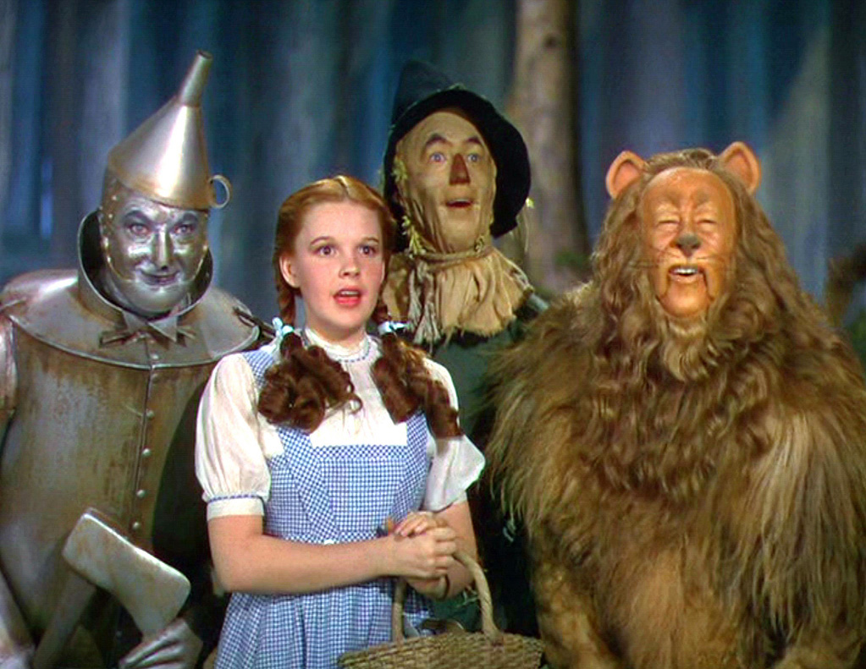

Slide 10
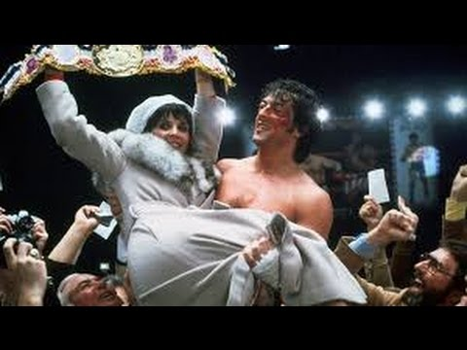

Slide 14
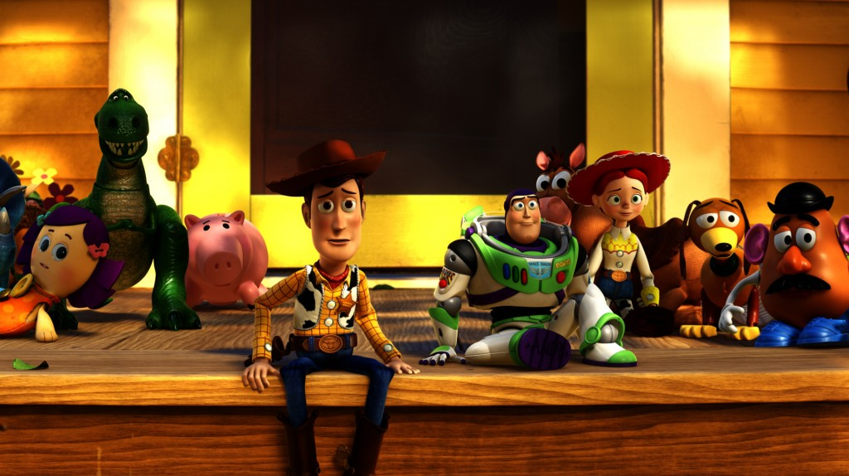

Slide 15
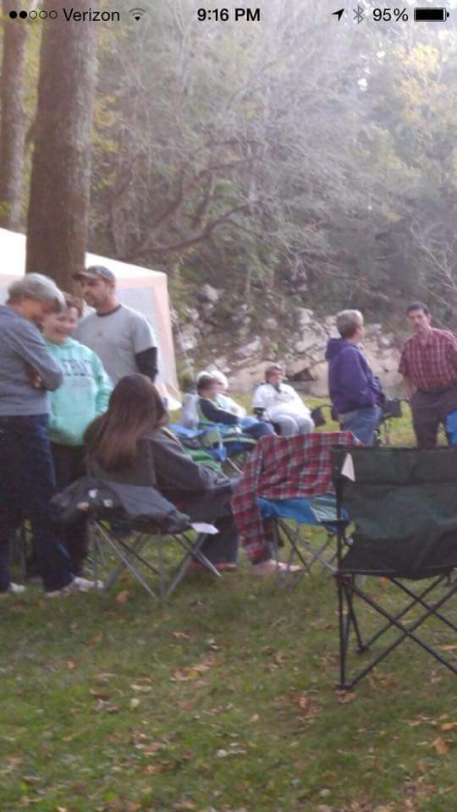

Slide 16
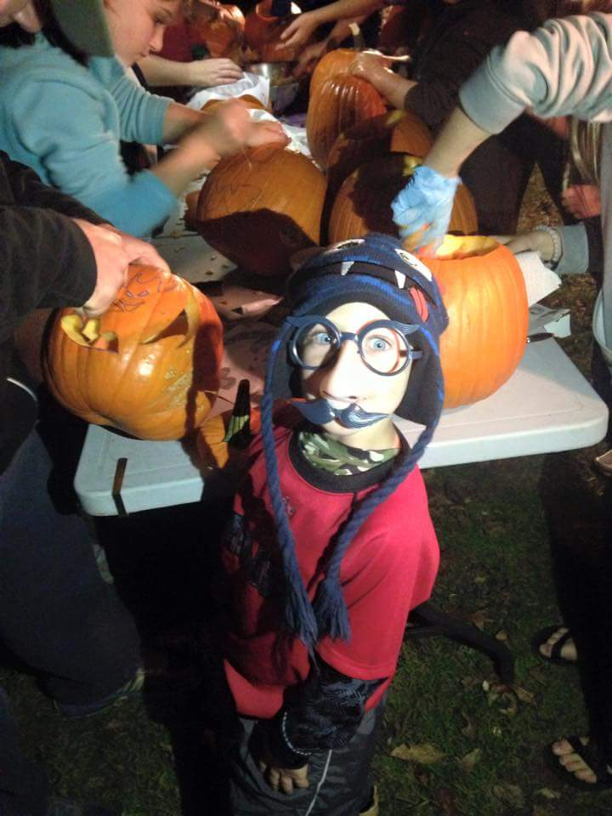

Slide 17
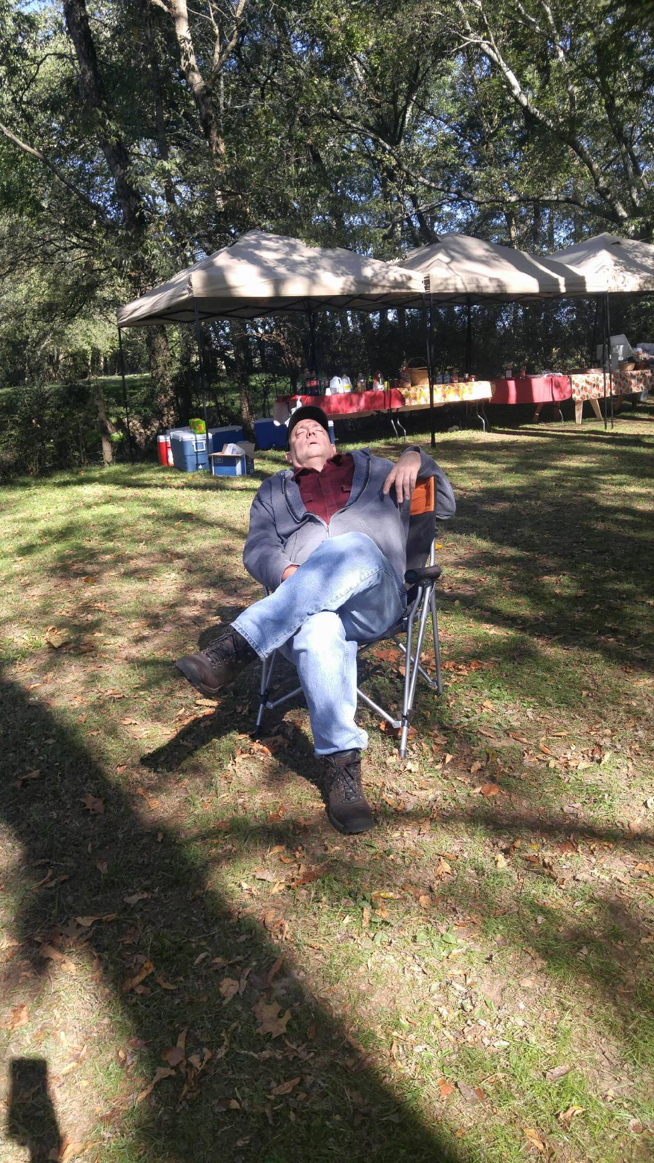

Slide 18
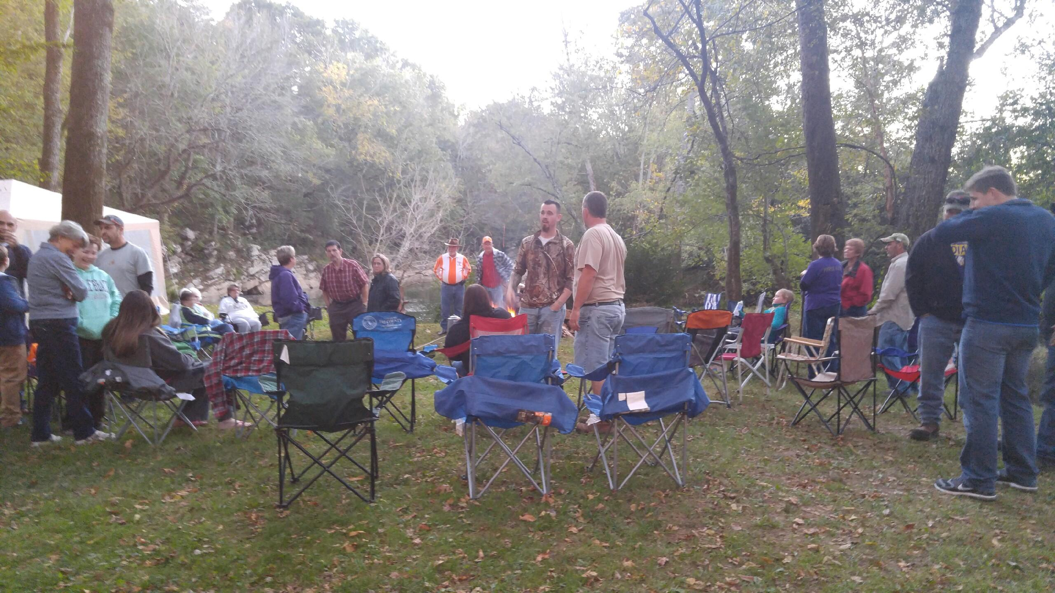

Slide 19
What is your story?

Slide 20
1. We all have a story.
Zacchaeus (Luke 19:1-10)
Peter (Luke 22:61)
Paul (Phil. 3:1-11)

Slide 21
1. We all have a story.
Rich Young Ruler
Luke 18:18-23
Felix/Agrippa
Acts 24:25/Acts 26:28

Slide 22
2. Your story can change.
Our stories
ebb and flow
rise and fall
move and change

Slide 23
2. Your story can change.
That is a good thing!
I Corinthians 6:9-11
Romans 1:16
Ephesians 4:17-24

Slide 24
2. Your story can change.
That is a bad thing!
II Peter 2:21-22
Hebrews 10:26-27

Slide 25
3. Our stories end the same.
Our stories make up who we are!
We can not change the past…….but…

Slide 26
3. Our stories end the same.
That does not mean we can stay the same.

Slide 27
3. Our stories end the same.
That DOES NOT mean we can stay the same.

Slide 28
3. Our stories end the same.
II Peter 3:9
Not willing that any should perish
But that all should come to repentance.

Slide 29
3. Our stories end the same.
I Peter 2:9-10
Our stories end with us on the same side, fighting the same battles, serving the same Living God.

Slide 30
What is your story?

Slide 31
Blessed Assurance
Jesus is mine
Foretaste of glory
Heir of salvation
Purchase of God
Born of His Spirit
Washed in His blood
All is at rest
Filled with His goodness
Lost in His love

